Slide 1
COBRA Take-ons – Options for PEOs
Process Timeline
4 Weeks
3 Weeks
2 Weeks
1 Week
5 Weeks
Implementation
API Integration
Portal Entry
Open Enrollment
Updated Coverage
Enrollment Form
PEO works with the QB to enroll in active plans. Once determined, PEO enters takeover QB in COBRA portal
Establish this process in advance so placeholder plans are automatically assigned to all new divisions. PEO enters takeover QB into the COBRA portal enrolled in applicable placeholder medical, dental and/or vision plans with applicable cover tier and submits a ticket to set up the OE.
Placeholder Plans
Closest Plans
PEO enters takeover QB in the COBRA portal enrolled in the closest available plans and then submits a ticket to set up the OE.

Slide 2
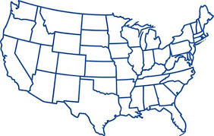
State Continuation
Standard practice: If a member inquires about state continuation extending past federal COBRA, we will contact the PEO for confirmation. However, if we have a way to identify the plans or a plan list is provided, we can automatically extend coverage.
Example: Plans underwritten in the state of New York allow employees to extend coverage up to 36 months.
ThrivePass will extend coverage upon request
Cal-COBRA – Members elect coverage and pay premiums directly to the health insurance carrier
Mini-COBRA: If the COBRA Electable flag is checked on the plan, we will pull in this plan through the integration and administrate in line with federal COBRA. If there are plans with different configuration needs, a plan list and requirements can be provided during implementation for scoping. Ongoing maintenance needed.

Slide 3

Client Terminations
Important: Please communicate client terminations on a monthly basis at least 30 days in advance.
Include date of termination
Include instructions on how to handle qualified beneficiaries
  Is the client required to take COBRA with them? If so, we can end coverage based on the term date for enrolled and pending members
  If COBRA administration will continue, do you want a way to identify terminated clients? We can add a “ZZ” to the division name for reporting purposes
    Be sure to instruct us if some plans will remain active and some should be inactivated.
      Example: continue COBRA on master plans terminate any client sponsored plans
    At plan renewal, instruct ThrivePass how to manage the COBRA open enrollment for members under a terminated client

Slide 4
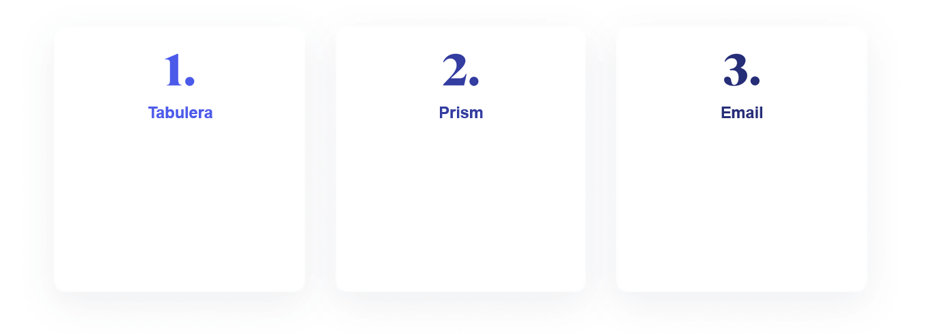

Carrier Notifications
We can partner with Tabulera to send COBRA enrollments and terms to the carrier for existing EDI feeds
Ingest COBRA enrollments and terms back into the Prism COBRA Module to be included on existing EDI feeds with your carriers
ThrivePass will send secure emails to the carrier to reinstate and/or terminate coverage for your COBRA members
Be sure to add COBRA eligibility carrier contacts to the PayeeID
Share any special requirements including instructions for urgent requests with ThrivePass

